Slide 1

E-Commerce
BCA VI SEM
FEB
2024

Slide 2
Unit I

Slide 3

UNIT-I
Introduction to E-Commerce
Overview of Electronic Commerce (E-Commerce)
Types of E-Commerce
Advantages & Challenges of E-Commerce
Scope of Electronic Commerce
Traditional Commerce vs. Electronic Commerce

Slide 4

What is ecommerce?
E- Commerce or electronic commerce refers to the buying and the selling of the goods and services over the internet including the monetary transactions that take place in exchange for these services and goods.

Slide 5

Ecommerce refers to the paperless exchange of business Information using the following ways:
Electronic Data Interchange (EDI)
Electronic Mail (e-mail)
Electronic Bulletin Boards
Electronic Fund Transfer (EFT)

Slide 6
E-COMMERCE
Non-Cash Payment
24x7 Service availability
Advertising / Marketing
Improved Sales
Inventory Management
Customer support
FEATURES

Slide 7
E-COMMERCE
Cost Effective
Scalability
Global Reach
Round the clock Availability
Better Customer Service
Saves time
ADVANTAGES

Slide 8
CHALLENGES E-COMMERCE
Learning Curve
Network Issues
Growing Competition
Lack of Security
Data Protection & Integrity

Slide 9
TYPES OF E-COMMERCE
Business - to - Business (B2B)
Business - to - Consumer (B2C)
Consumer - to - Consumer (C2C)
Consumer - to - Business (C2B)

Slide 10
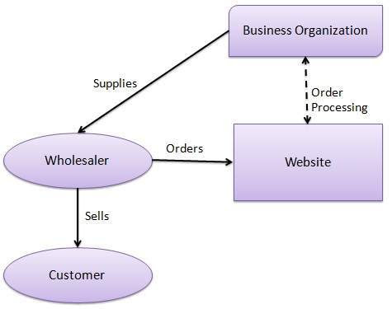
BUSINESS - TO - BUSINESS (B2B)
A website following the B2B business model sells its products to an intermediate buyer who then sells the product to the final customer.
Business-to-business is referred to as B2B. Business-to-business companies produce goods and services for other businesses and organizations. Examples of B2B companies are marketing agencies, software as a service (SaaS), and companies that produce and sell numerous goods.

Slide 11
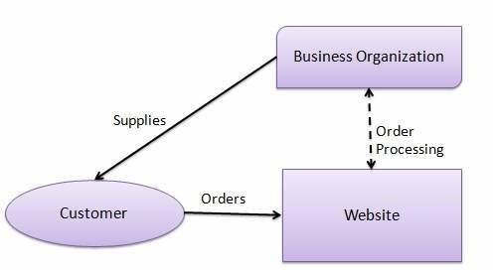
BUSINESS - TO - CONSUMER (B2C)
In B2C, business model sells its products directly to a Customer.
Business-to-consumer is a business strategy that involves selling goods directly to consumers rather than going through wholesalers, retailers, or other middlemen. Business-to-consumer is referred to as B2C. The B2C model can be used in any business transaction where the consumer receives products or services directly, such as restaurants, retail stores, and hospitals. Amazon, Netflix, and Etsy are examples of B2C e-commerce stores.

Slide 12
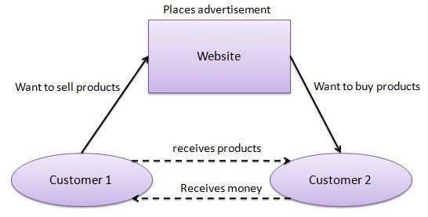
CONSUMER - TO - CONSUMER (C2C)
• In C2C, good or services are sold and purchased between two consumers.
Consumer-to-consumer is referred to as C2C. C2C e-commerce directly sells products or services between customers. C2C is frequently made possible through third-party websites or marketplaces, which handle transactions on behalf of buyers and sellers. C2C transactions don't involve any type of company. Smaller companies or hobbyists can offer goods on e-commerce marketplaces without maintaining their web presence. C2C platforms are beneficial for both buyers and sellers, and the platforms make money by charging a small cost for each transaction, such as the advertising fee for products.

Slide 13
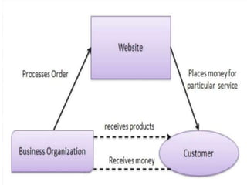
CONSUMER - TO - BUSINESS (C2B)
In this model, a consumer approaches a website showing multiple business organizations for a particular service.
Consumer to business is referred to as C2B. In this business model, the consumer produces value, which is then consumed by businesses. For example, when a customer writes reviews or gives a valuable suggestion for a new product, this customer adds value to the company if the company uses that input.

Slide 14
SCOPE OF E-COMMERCE
Accounting
Commercial transactions: ordering, delivery, payment
Technology-Enabled
Exchange of digitized information
Interface with customer.- customer information gathering

Slide 15
Traditional / Electronic
Traditional Commerce | Electronic Commerce
Heavy dependency on information exchange from person to person | Information sharing is made easy via electronic communication channels making little dependency on person to person information exchange
Communication/ transaction are done in synchronous way. Manual intervention is required for each communication or transaction | Communication Of transaction can be done in asynchronous way. Electronics system automatically handles when to pass communication to required person or do the transactions
It is difficult to establish and maintain standard practices in traditional commerce. | A uniform strategy can be easily established and maintain e-commerce.
Communications of business depends upon individual skills. | In e-Commerce or Electronic Market, there is no human intervention.
No uniform platform for information sharing as it depends heavily on personal communication. | E-Commerce provides a universal platform to support commercial / business activities across the globe.

Slide 16
IMPORTANT QUESTION
How E-commerce is more beneficial than traditional commerce?
Explain various categories of e-commerce.
Compare and contrast scope and challenges of E-commerce.

Slide 17
IMPACTS OF E-COMMERCE
ELECTRONIC MARKET
ADVANTAGES OF ELECTRONIC MARKET
INTERNET COMMERCE

Slide 18
E-COMMERCE IMPACTS
Consumer impact
Direct communication with customers
Greater choice
Buying ,selling of goods and services online and doing all the transaction electronically.

Slide 19
ELECTRONIC MARKETS
An electronic market is an inter-organisational information system that provides facilities for buyers and sellers to exchange information about price and product offerings
The electronic market is primarily about the search phase of the trade cycle.
The electronic market is most effective in assisting the buyer in a commodity market where products are essentially identical across all sellers.
In a differentiated market there is a variety of product offerings and the search problem is more complex.

Slide 20
FUNCTIONS OF ELECTRONIC MARKET
Act as an exchange for business transactions
Manage catalog content
Provide support to trading process

Slide 21
ADVANTAGES OF E-MARKETING
Much better return on investment from than that of traditional marketing
E-marketing means reduced marketing campaign cost
Fast result of the campaign
Easy monitoring through the web tracking capabilities

Slide 22
INTERNET COMMERCE
Internet commerce is like a subset of e-commerce. Internet Commerce is the use of the Internet for all phases of creating and completing business transactions

Slide 23
FEATURES OF INTERNET COMMERCE
The full sales and marketing cycle
Identifying new markets
Developing ongoing customer relationships
Assisting potential customers with their purchasing decision
Providing round-the-clock points of sale
Supply Chain Management
Ongoing Customer Support

Slide 24
STAGES OF INTERNET COMMERCE
The World-Wide Web as an online product catalogue
Pre-sales support through electronic mail
Full transaction processing for placing orders
Delivery of product or product update information
Collecting details of prospective customers' interests
Provision of interactive discussion facilities for customers

Slide 25
ADVANTAGES
Timeliness
Reduced Marketing Costs
Better Targeting
Greater Market Reach

Slide 26
ISSUES AND CHALLENGES
Authentication
Security
Legislation Harmonisation
Payment

Slide 27
IMPORTANT QUESTIONS
1. Explain How E-commerce is affecting our society and economy?
2. Explain How Electronic market is being used various organizations?

Slide 28
Different perspective of e-commerce
Direct marketing
Application of e-commerce in direct marketing.
Impacts of e-commerce on direct marketing
Future of E-commerce in India
Obstacles of E-commerce

Slide 29
DIFFERENT PERSPECTIVE OF E-COMMERCE
Communication
Interface
Business process
Online
Structure
Market
Community

Slide 30
WHAT IS DIRECT MARKETING?
Direct marketing is defined as selling products by direct contact with customers without using a retail store. Mail-order catalogues and telephone solicitation are examples of direct marketing.
Direct marketing is a very popular and widely used method of informing people about products and services in order to make sales. It's a method of contacting customers and potential customers personally.

Slide 31
FEATURES OF DIRECT MARKETING
Direct Response
Reduced Cost
One-to-One Communication
Target Audience
Generation of responsive feedback
Increase in customer satisfaction

Slide 32
APPLICATION OF E-COMMERCE IN DIRECT MARKETING.
Telemarketing
Catalogue Marketing
Internet Marketing
Mobile Marketing

Slide 33
Direct Marketing
Direct Mail
Direct Advertising
Telemarketing
Direct selling
Couponing
Email Marketing
Broadcast Faxing

Slide 34
Internet Marketing
E-mail Marketing
Web marketing
Social media marketing

Slide 35
IMPACTS OF E-COMMERCE DIRECT MARKETING.
Product Promotion
New Sales Channel
Direct Savings
Reduce Cycle Time
Customer Service

Slide 36
ADVANTAGES OF DIRECT MARKETING
Saves distribution costs
Product or service at door step
Understand customer requirement better
Find new customers

Slide 37
FUTURE OF E-COMMERCE IN INDIA
Social Media
Drone Delivery
Google's Buy Now Button
Artificial Intelligence

Slide 38
OBSTACLES OF E-COMMERCE
lack of computer knowledge
Maintaining customer loyalty
Return and Refund Policy
Online payment fraud
Absence of online verification of customers
Customer Service

Slide 39

THANK YOU!

